Slide 1
SUPERMARKET POS SYSTEM
Term Project on Object Oriented Programming

Slide 2
Team Members:
Ramisa Maliat (180041131)
Fahim Faisal (180041135)
Samiha Shafiq Anuva (180041137)

Slide 3
Our Project
Our project is implementation of the POS (Point of sale) system for a supermarket.
This software will help to do transactions efficiently and store and update information about products, customers and employees of different branches of the supermarket.

Slide 4
Features
Authorization and accessibility to information for different users
Employee management
Branch management
Customer management
Inventory and stock management
Billing and order processing
A graphical user interface

Slide 5
Different Users and Authorization
Three types of users can access the system – administrator, manager and cashier.
Users can only access using their user ID and password.
Administrators can access and modify information of all the branches, whereas managers and cashiers have accessibility to the information only related to their own branch according to their role.
A user can update only those information about him/her that he/she is allowed to do.

Slide 6
Employee Management
Two types of employees can directly interact with the system as users: manager and cashier. Others do not have any accessibility.
Employees can be added and deleted. Information of all the current and old employees will be stored.
Administrators can update information of any employee in any branch.
Managers can update information of the employees of their own branch only according to the privileges they have.

Slide 7
Branch Management
Administrators can view and update any information of the branches.
Managers and cashiers can access the information of their own branch. They do not have authority to update branch information.

Slide 8
Customer Management
Customers can get membership and have discounts in their purchases from the supermarket. Personal information of the member customers will be stored.
Users of the system can update the customer and their membership information any time.

Slide 9
Inventory and Stock Management
Along with the product details, the information of daily requirement and available quantity of the products in any branch are stored.
After every purchase by customers, product information is updated by default.
A manager can restock the products of his/her branch. He/she can update daily requirement and available quantity of these products.
Administrators can update any information of the products along with adding and removing them.

Slide 10
Billing and Order Processing
Cashiers can pass customers’ list of orders as input to the system to generate bill. They can also view product details of their branch while taking the order.
For member customers bill is generated with discount as well. Customer’s information is also displayed where the validity of his/her membership can be checked.
After issuing a bill, information of available products gets updated by default.

Slide 11
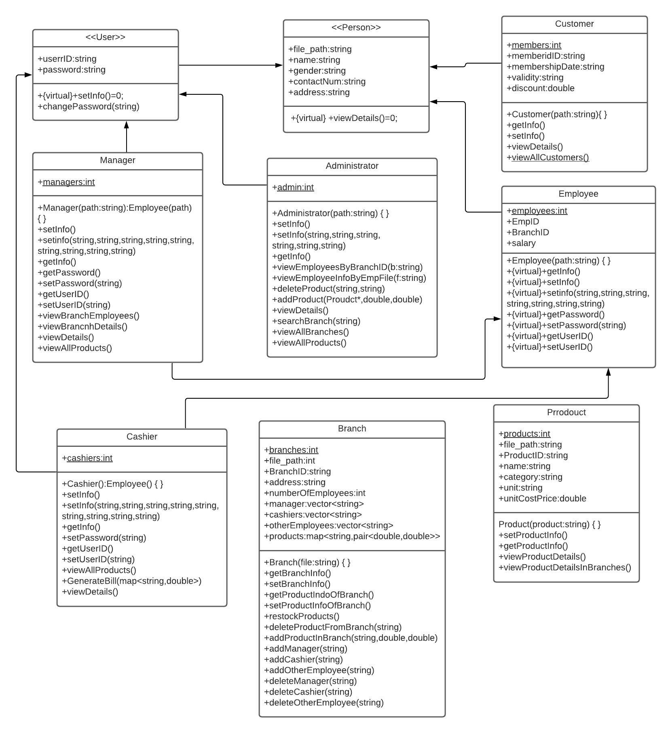
UML Class Diagram

Slide 12
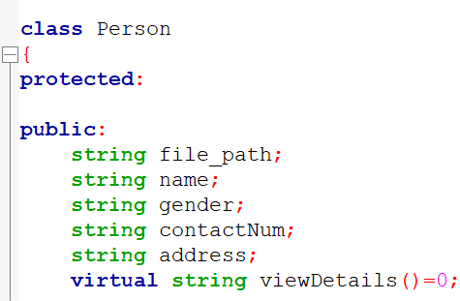
Implementation
The whole project is based on object oriented programming concept. Total of 9 classes are used to implement this where 2 of them(“Person” and “User”) contain pure virtual functions and cannot be instantiated. Constructors take file path as parameter where the information related to an object is stored.
File I/O is used to store all the information of the system.

Slide 13
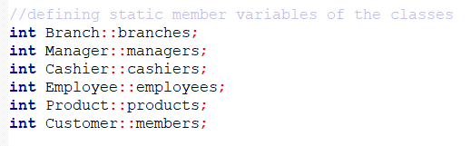
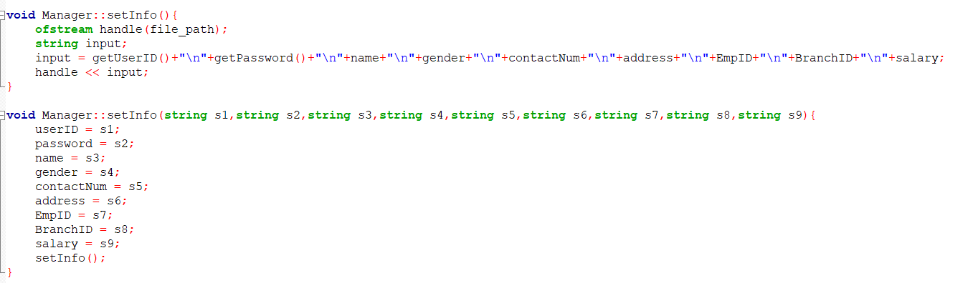
Implementation
Static member variables of classes are used to generate all the IDs (i.e. Employee ID, User ID, Customer ID etc.) for the system automatically.
Overloading is used to set values of classes with or without parameters.

Slide 14
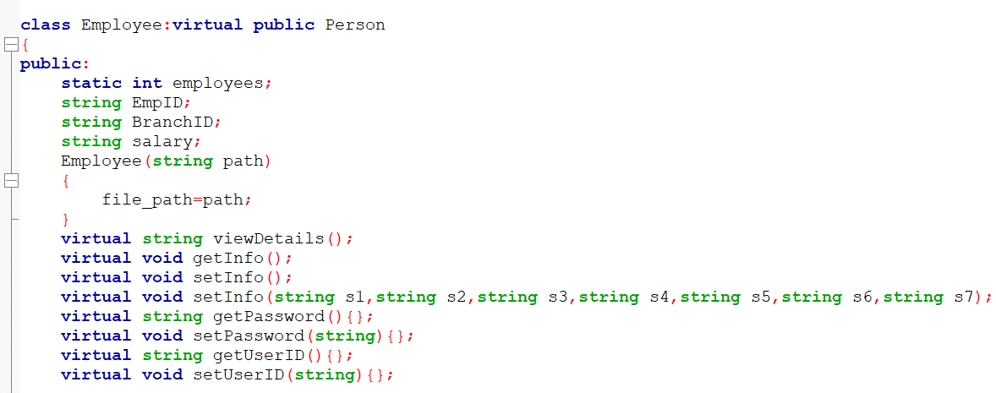
Implementation
Virtual functions are used in base classes to add extended features by overriding them in derived classes such as – “Manager” and “Cashier” that are inherited from “Employee” and “User”.

Slide 15
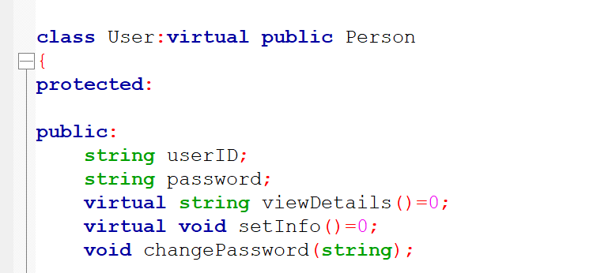
Implementation
Virtual Base Class is used to avoid ambiguity in class hierarchy having multiple inheritance. For example, “Person” is made a virtual base class for both “User” and “Employee” class to prevent multiple instances of it in “Manager” and “Cashier” class.

Slide 16
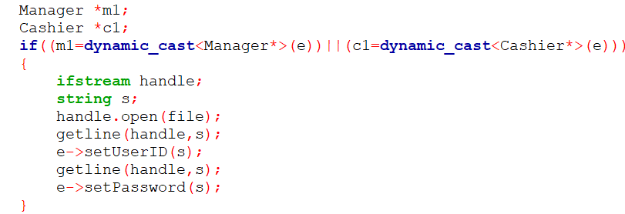
Implementation
RTTI(Run-time Type Information) is used in different parts of the project to get information of the objects, for example, inside the function of logging into the system to check the type of the user.
windows.h header is used to build the graphical user interface. A stack keeps track of the windows that are opened.

Slide 17
Contributions of Group Members
Ramisa Maliat (180041131) :
Creating necessary classes and functions for the administrator user.
Creating all the buttons and required layout for the administrator user.
Creating several other required classes and functions that are not directly related to those for the users.
Fahim Faisal (180041135) :
Creating necessary classes and functions for the cashier user.
Creating all the buttons and required layout for the cashier user.
Samiha Shafiq Anuva (180041137) :
Creating necessary classes and functions for the manager user.
Creating all the buttons and required layout for the manager user.

Slide 18
Challenges
As file I/O is used to store data, maintaining integrity among information thoughout the whole system was difficult.
To avoid redundancy of data, multiple folders and files are used which required more lines of code.
Much time and many trials were required to develop a smooth user-friendly GUI.

Slide 19
Future Goals
Adding feature of storing details of each order by any customer along with transaction history of all branches.
Adding feature of storing purchase history in all branches of any member customer.
Developing more auto generated responses from the system for incorrect or inconsistent input by the users.
Developing a better GUI.
Introducing databases to handle the system more efficiently.

Slide 20
Thank you!

